Slide 1
FCIA 64GFC PlugFest Oct.23 to Oct. 27 (8 to 5) plugfest@lists.fibrechannel.org
Host: FCIA at UNH-IOL GPT lab
NDA required for participation began on 9/20/2023
Plugfest general information page: https://fibrechannel.org/plugfest-general-info/
NDA: https://fibrechannel.org/wp-content/uploads/2023/08/NDA-Plugfest-2023-update.pdf
Plugfest Registration Page: https://fibrechannel.org/plugfest-registration-payment/

Slide 2
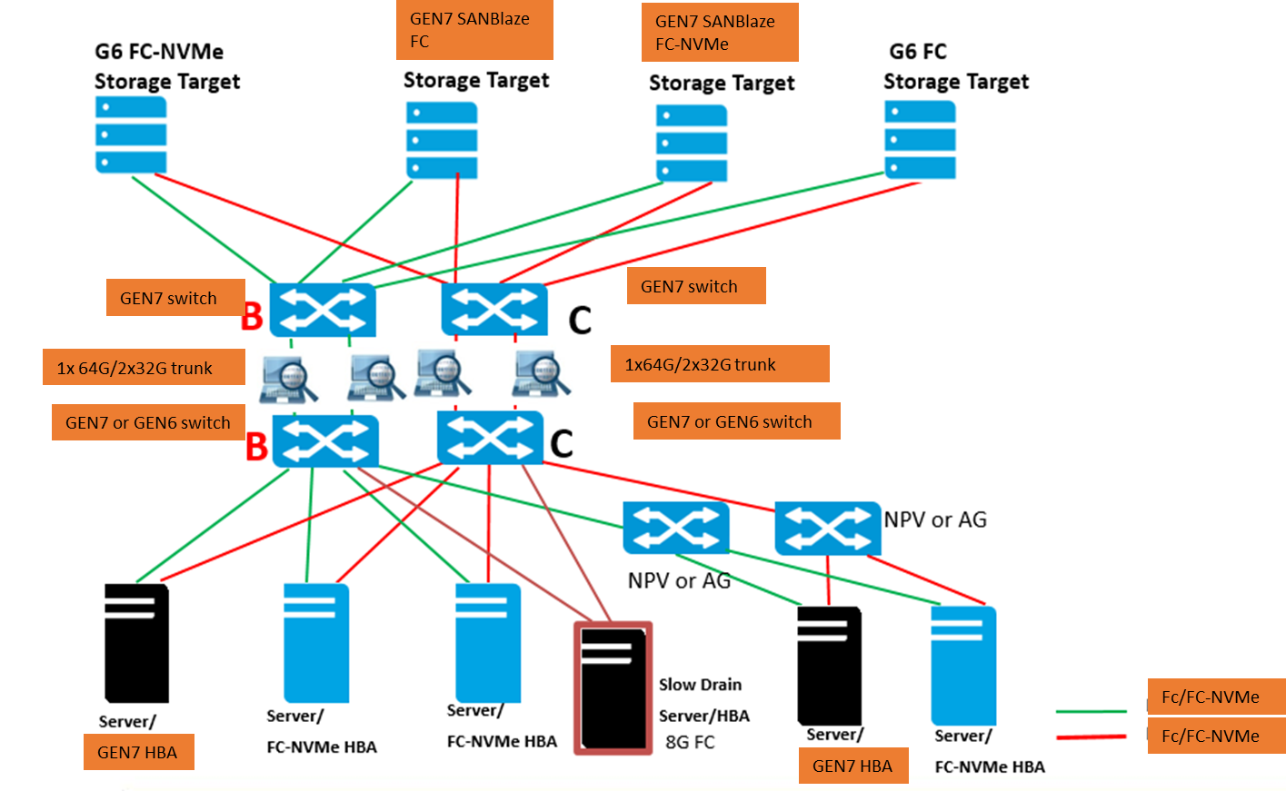
PlugFest topology - 1GbE OOB MGMT SWITCH (~16 PORTS)
RJ45 serial switch or USB to RJ45 adapters
Demonstrate trunk advantage vs ISLs (DSL)
Verify FDMI data

Slide 3
PlugFest Participants mailto:plugfest@lists.fibrechannel.org
1. Adtran | Andy – out Thursday and Friday. | Point to point link equipment - 16/32 with Cisco demonstrated – need to test 64GFC; Brocade – 64/32/16 demonstrated. | 1 shelf two blades – support MMF or SMF HOST connectivity and trunks and mixed speeds. Cisco and Brocade on different client ports at same time. | Provide longer latency | Supports a x7 lane trunk
2. Amphenol | Chris | 64GFC Transceivers supported by Marvell and HPE-Q. | working on providing OM4 LC cables
3. Broadcom | Mark | 2 servers – I or T SPDK – share NVMe-oF target. Two Brocade G720 switches – check for extension and trunk license ? | FPIN LI in Linux – sent to host MPIO path management flap . Note: if device not registered for FPIN it is difficult to identify congestion cause | Switch and adapter Optic lock – will try to bring adapter unlocked FW | Oversubscription + long latency
4. Cisco | Kiran | 2 switches – trunking + E port all features are supported | Dozen optics, just a couple of LRs – 64/32G
5. EXFO | Eric | Two 88480 two 88360 32G/64G interop with optics. | Link with point to point for fabric – training and login. Serves an end point to validate link level protocol and signal quality. BER analysis. | 32G/64G interop
6. HPE | Barry and Matt Barry out Wednesday | Extra 64GFC Q and E HBAs for IOL server install. | 3 DL360 G11 servers - B and Q 64GFC HBAs; 1 32/16/8GFC HBA; Sanblaze FC 6x64GFC | OM4 cables mgmt laptop | 1G OOB mgmt switch (172.17.xx.xx subnet) + RJ45 Serial switch
7. Marvell | Ray | Two servers – 3 OSs – RH, WS, Ubuntu – 64GFC HBA | 32GFC HBA for UNH server and other testing | HBA Optics lock not implemented
8. NetApp | Sunil | tbd
9. Sanblaze | Steve | Capability to Send FPIN – but does not cause congestion | Two SANBlaze servers – 8 FC ports available I or T; 2 64GFC Marvell HBAs; 2 64G Broadcom HBAs | Any of 8 ports can be I or T; FC or FC-NVMe
10. Teledyne LeCroy | Jim/Craig/Josh | 2 M648 – inline initially on B and C ISL | Jammer licensed to drop credits to idle | Change status on return path to cause an LI event
11. UNH | James and Tim | GPT bench layout - Switches and analyzers and Adtran blades in center, servers on edges | Two or 3 systems for 64/32GFC HBA installs for Ubuntu/Interact FC-NVMe conformance tests | 15 Medusa licenses available | Will install 64GFC HBAs – can setup as regular servers with 32G or 64G HBAs
 | Head count 15 to 20 | Shipping – arrive by Oct. 20. | Friday - Packing can be supported by the IOL | Food service – is good to go. | Holliday Inn Express is within walking distance

Slide 4
Test Tracks
 | M |  | Tu |  | W |  | Th |  | F
Adtran-B
Adtran-C
Amphenol-xcvrs
Broadcom SW1
Broadcom SW2
Broadcom S1
Broadcom S2
Cisco SW1
Cisco Sw2
EXFO-1 | verify all 64GFC xcvrs
EXFO-2
HPE S1
HPE S2
HPE S3
HPE SBZ-T1
HPE SBZ-T2
Marvell S1
Marvell S2
NetApp
Sanblaze SE1-T
Sanblaze SQ2-T
Sanblaze SE1-I
Sanblaze SQ2-I
TDLC-1
TDLC-2
UNH-S1 | Each HBA model conformance verified by INTERACT with Q and E SBZ target
UNH-S2
UNH-S3

Slide 5
UNH-IOL Interact use for FC-NVMe conformance
Ubuntu 20.04 & 22.04 are stable and will be capable of running Interact fully, so if you plan to use these operating systems you should be all set!
22.04 Kernel 5.15 downgrade to 5.10 (less coverage if cannot downgrade)
For RHEL 9.1 & 9.2 we ran into more issues than occurred on 9.0.
While we can get the tool installed the kernel is limiting the number of tests that can be run substantially on initial testing.
The main issue we are running into is the newer kernel has config_struct_devmem enabled.
This causes two NVMe cli commands to fail (nvme list, & show-regs) these commands are the only commands that map PCIe bars into user space.
This issue is occurring on PCIe and it might not occur on a fabrics setup.
Interact relies on the get-property command instead.
Further investigation – kernel 5.14 has issues – not full coverage

Slide 6
Adtran optical transport – Consensus is yes
I'm envisioning us setting up our transport gear as a secondary optical link between the B Switches.
Traffic can be run via the direct link for a portion of the time, and then we can also run traffic via our transport gear as well.
This would allow us to demonstrate our ability to run FC traffic over distance, with trunking, at multiple data rates (as desired).
Note: HPE to provide 20-25km SMF LC pods (2 or 4) and patch cables

Slide 7
UNH-IOL discussion
IOL can provide Medusa licenses – ok on Ubuntu, RH, WS
IO test tools – Medusa; FIO; IOMETER
INTERACT logs are proprietary to consortium members
No detailed logs – pass fail indicator – logs can be obtained by joining or paying per test
Bring extra HBAs for IOL servers (if driver is in box)
SPDK – target to get more nvme ports. Broadcom can bring a server.
SANBlaze can be target or initiator FC and/or FC-NVMe
HPE bring a 64GFC SANBlaze – for additional target ports

Slide 8
HPE ProLiant DL360 Gen11 servers P51931-B21
Server Name | iLO IP Address | Server Management Address | Operating System | Adapter | Adapter Port 1 (on switch) | Adapter Port 2 (on switch)
Rack-E18-UNH1 | 172.17.5.88 | 172.17.5.91 | Ubuntu | SN1700E 64GFC HBA | Port 41 (Port 0 on adapter) 10:00:b4:7a:f1:6d:14:ed | Port 45 (Port 1 on adapter) 10:00:b4:7a:f1:6d:14:ee
Rack-E18-UNH2 | 172.17.5.89 | 172.17.5.92 | RHEL 9.2 | SN1700Q 64GFC HBA | Port 42 51:40:2e:c0:17:2b:76:bc | Port 46 51:40:2e:c0:17:2b:76:be
Rack-E18-UNH3 | 172.17.5.90 | 172.17.5.93 | WS2022 | SN1700E 64GFC HBA | Port 43 (Port 0 on adapter) 10:00:B4:7A:F1:6E:64:72 | Port 47 (Port 1 on adapter) 10:00:B4:7A:F1:6E:64:73
Note: Trunking needs to be enabled on both switches, it is by default, and the ISL of a single switch needs to all be on the port group.

