Slide 1
FCIA 64GFC PlugFest plugfest@lists.fibrechannel.org
Host: FCIA at UNH-IOL GPT lab
NDA required for participation began on 9/20/2023
Plugfest general information page: https://fibrechannel.org/plugfest-general-info/
NDA: https://fibrechannel.org/wp-content/uploads/2023/08/NDA-Plugfest-2023-update.pdf
Plugfest Registration Page: https://fibrechannel.org/plugfest-registration-payment/

Slide 2
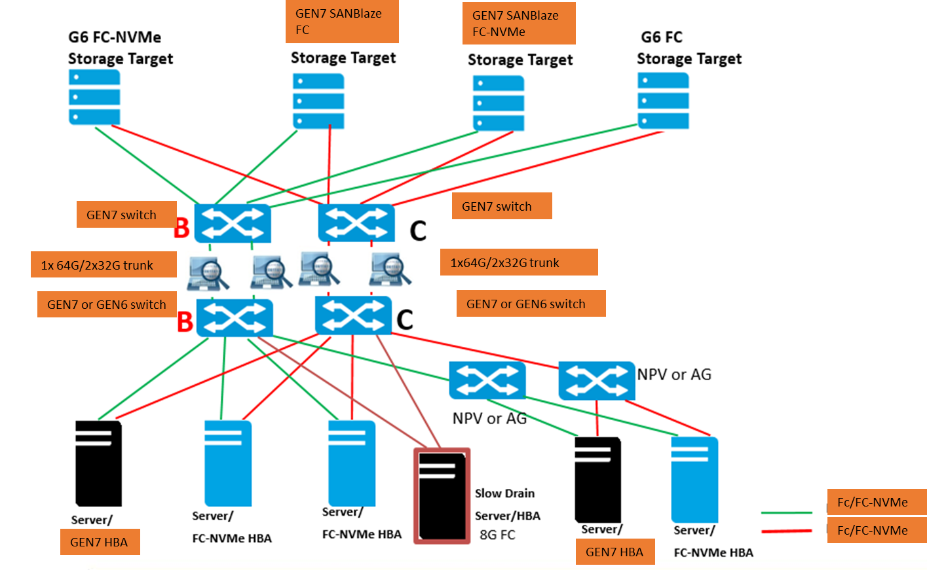
PlugFest topology - 1GbE OOB MGMT SWITCH (~16 PORTS)
RJ45 serial switch or USB to RJ45 adapters
Demonstrate trunk advantage vs ISLs (DSL)
Verify FDMI data

Slide 3
PlugFest Participants
1. Adtran | Andy |  | 1 shelf two blades – support MMF or SMF HOST connectivity and trunks and mixed speeds | Provide longer latency | Supports a x7 lane trunk
2. Amphenol | Chris |  | Still working on OM4 cables | 64GFC Transceivers supported by which participants? (locks)
3. Broadcom | Mark |  | FPIN LI in Linux – sent to host MPIO path management flap . Note: if device not registered for FPIN it is difficult to identify congestion cause | Optic lock – try to bring unlocked FW | Oversubscription + long latency
4. HPE | Barry and Matt |  | 3 G11 servers B and Q 64GFC HBAs; 1 8/16G HBA | 1 64GFC B switch SMF pods OM4 cables | 1G OOB mgmt switch + RJ45 Serial switch
5. Marvell | Ray |  | 64GFC HBAs | Optics lock implemented
6. Sanblaze | Steve | Capability to Send FPIN – but does not cause congestion | One SANBlaze server
7. Teledyne LeCroy | Jim and Craig | 2 M648 | Jammer to drop credits to idle | Change status on return path to cause an LI event
8. UNH | James and Tim | Switches in center adapters on edges | Two or 3 systems | 15 licenses
9. Cisco | Kiran | 2 switches | Dozen optics, just a couple of LRs
10. NetApp | Sunil
11. EXFO | Eric |  |  | 32G/64G interop
 | Head count 15 to 20 | Food service

Slide 4
UNH-IOL Interact use for FC-NVMe conformance
Ubuntu 20.04 & 22.04 are stable and will be capable of running Interact fully, so if you plan to use these operating systems you should be all set!
22.04 Kernel 5.15 downgrade to 5.10 (less coverage if cannot downgrade)
For RHEL 9.1 & 9.2 we ran into more issues than occurred on 9.0.
While we can get the tool installed the kernel is limiting the number of tests that can be run substantially on initial testing.
The main issue we are running into is the newer kernel has config_struct_devmem enabled.
This causes two NVMe cli commands to fail (nvme list, & show-regs) these commands are the only commands that map PCIe bars into user space.
This issue is occurring on PCIe and it might not occur on a fabrics setup.
Interact relies on the get-property command instead.
Further investigation – kernel 5.14 has issues – not full coverage

Slide 5
Adtran optical transport – Consensus is yes
I'm envisioning us setting up our transport gear as a secondary optical link between the B Switches.
Traffic can be run via the direct link for a portion of the time, and then we can also run traffic via our transport gear as well.
This would allow us to demonstrate our ability to run FC traffic over distance, with trunking, at multiple data rates (as desired).
Note: HPE to provide 20-25km SMF LC pods (2 or 4) and patch cables

Slide 6
UNH-IOL discussion
IOL can provide Medusa licenses – ok on Ubuntu, RH, WS
IO test tools – Medusa; FIO; IOMETER
INTERACT logs are proprietary to consortium members
No detailed logs – pass fail indicator – logs can be obtained by joining or paying per test
Bring extra HBAs for IOL servers (if driver is in box)
SPDK – target to get more nvme ports. Broadcom can bring a server.
SANBlaze can be target or initiator FC and/or FC-NVMe
HPE bring a 64GFC SANBlaze – for additional target ports

Slide 7
HPE servers
Server Name | iLO IP Address | Server Management Address | Operating System | Adapter
Rack-E18-UNH1 | 172.17.5.88 | 172.17.5.91 | Ubuntu | SN1700E 64GFC HBA
Rack-E18-UNH2 | 172.17.5.89 | 172.17.5.92 | RHEL 9.2 | SN1700Q 64GFC HBA
Rack-E18-UNH3 | 172.17.5.90 | 172.17.5.93 | WS2022 | SN1700E 64GFC HBA
Note: Trunking needs to be enabled on both switches, it is by default, and the ISL of a single switch needs to all be on the port group.

